Slide 1
Employee Data Analysis using Excel
STUDENT NAME: JEEVA.S
REGISTER NO:312201040(asunm110312201040)
DEPARTMENT:B.COM(ACCOUNTING AND FINANCE)
COLLEGE:DRBBCCC HINDU COLLEGE

Slide 2
PROJECT TITLE
Employee Performance Analysis using Excel

Slide 3


AGENDA
Problem Statement
Project Overview
End Users
Our Solution and Proposition
Dataset Description
Modelling Approach
Results and Discussion
Conclusion
3/21/2024 Annual Review

Slide 4

PROBLEM STATEMENT Analyze employee performance using Excel to track productivity, efficiency, and goal achievement, enabling data-driven decisions for enhancing workforce development and organizational success.

Slide 5

PROJECT OVERVIEW Employee performance analysis using excel involves evaluating key metrics such as productivity, effciency, and goal achievement. By leveraging Excel’s data analysis tools, organizations can gain valuable insights, make informed decisions and implement strategies to enhance employee performance and overall business outcomes.
.

Slide 6

WHO ARE THE END USERS? The end users for employee performance analysis using Excel include HR managers, team leaders, department heads, and executives who need data driven insights too manage, evaluate and improve employee performance and productivity.

Slide 7

OUR SOLUTION AND ITS VALUE PROPOSITION 1. Track and analyze employee performance metrics using Excel’s data tools. 2. Create tailored performance reports to meet organizational needs. 3. Utilize cost effect1ive, existing Excel software for analysis. 4. Enable informed decision-making with clear, data-driven insights. 5. Identify areas for improvement, guiding targeted employee development.

Slide 8
Dataset Description The data consist of 26 features, here features used are 1. Employee Id - Which has numerical values 2. Employee Name – Which contains text 3. Employee Type 4. Performance Level of the Employee 5. Gender of the employee 6. Employee rating – Which has numerical values

Slide 9

THE "WOW" IN OUR SOLUTION
PERFORMANCE LEVEL =IF(Z8>=5,”VERY HIGH”,IF(Z8>=4,”HIGH”,IF(Z8>=3,”MEDIUM”,IF(“
TRUE”,”LOW”))))
3/21/2024 Annual Review

Slide 10
MODELLING
In the “Employee Performance Analysis Using Excel” project, the modelling phase involves setting up the
Excel workbook with various tools and techniques to analyze and visualize the data effectively.
1. Data Collection:
Collecting the data from ”Employee Dataset” by highlighting the cells of Employee Id, First name, Last name, Business unit, Employee status, Employee type, Gender code, Performance score and Current Employee rating.
2. Performance Level:
Converting the Current Employee Rating (numbers) into performance category (text) by using the formula.
Performance Category =IF(Z8>=5,”VERY HIGH”,IF(Z8>=4,”HIGH”,IF(Z8>=3,”MEDIUM”,IF(“TRUE”,”LOW”))))
3. Data Cleaning:
First, identity the missing value in the “Exit data” column by using the conditional formatting technique (format cells with blanks and fill with red color). Then, remove the blank cells in the exit date column by using filtering technique (filter by color and no fill).

Slide 11
4. Pivot Table: Pivot Table helps to summarize and analyze large datasets by grouping and aggregating the data based on different performance metrics. It also helps to visualize the data in an easily interpretable format, making trends and patterns more apparent. In this project, pivot table is used to show the performance category of the employee based on the different business units. We can also see only the male or female performance category of the different business units by using the filter option in the pivot table. 5. Slicer: In this project, slicer is used to show the different employee type like part-time, full-time and contract. For example, if we choose the full-time employee type in the slicer, e can see only the performance category of full-time employee based on the different business units. 6. Charts: In this project, Pie chart is used to show the pictorial representation of the performance category of the employee from a different business unit. We can also see only the male or female performance category of the employee separately. In this project, pie chart is used to show the pictorial representation of the specifically high performance category of the employee from a different business unit with a Data Label.

Slide 12
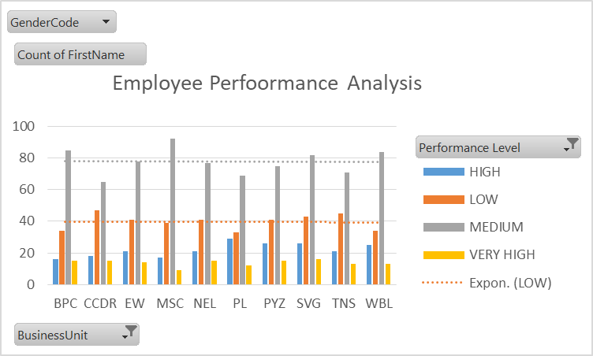
RESULTS

Slide 13
conclusion
Employee performance analysis using Excel offers a comprehensive approach to tracking and evaluating staff productivity. By leveraging Excel’s data management, visualization, and analytical features, organizations can gain valuable insights into employee performance, identity areas for improvement, and make informed decisions to drive overall productivity and organizational success.

